Slide 1

Washington DC
Crime Analysis using Big Data
Ka Bian, Siddharth Dixit, Wei Zhao

Slide 2
1
Time Series Analysis in SparkR
2
DBSCAN algorithm for Clustering Crime spots in Hadoop
Content
3
Result visualization & Front End Demo
4
Conclusion & Future work
Notes:
Experience of police shows that certain geographical areas called crime generators have high probability of occurrence of crime.

Slide 3
Crime analytics aids police in intelligently making decisions and proactively planning the defence mechanism
Biggest challenge of Crime analysis: processing large amount of historical data
Crime trends: Predicting the frequency pattern
Crime hotspots: concentration of crimes in specific geographical area, recurring over time
Data Set: Crime incidents 2011-2017 in DC
INTRODUCTION
Notes:
Experience of police shows that certain geographical areas called crime generators have high probability of occurrence of crime.

Slide 4
PART ONE
01
Time Series Analysis in SparkR

Slide 5
公Viable uses and how to proceed: 司文化
Collapse the dates into month format.
But Why?
Detect Patterns
2. Forecast crimes
3. Alter Security
Count frequency for each month.
Introduce seasonal and linear component!
Month | Linear | month = 1 | month = 2
01/2011 | 1 | 1 | 0
02/2011 | 2 | 0 | 1

Slide 6
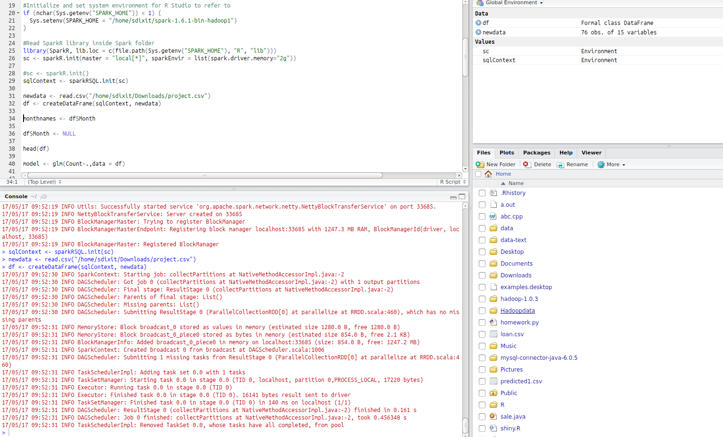
公Using SparkR inbuilt in Spark folder: 司文化
R Studio -> Spark Context (SC)
sqlContext <- sparkRSQL.init(sc)
New Dataset <- sqlContext
Regression
Summary
Predict
Output File (Collect, Write.csv)
Front End (Shiny!)

Slide 7
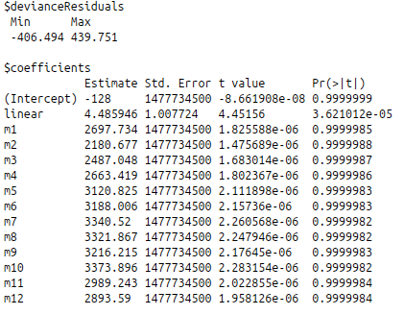
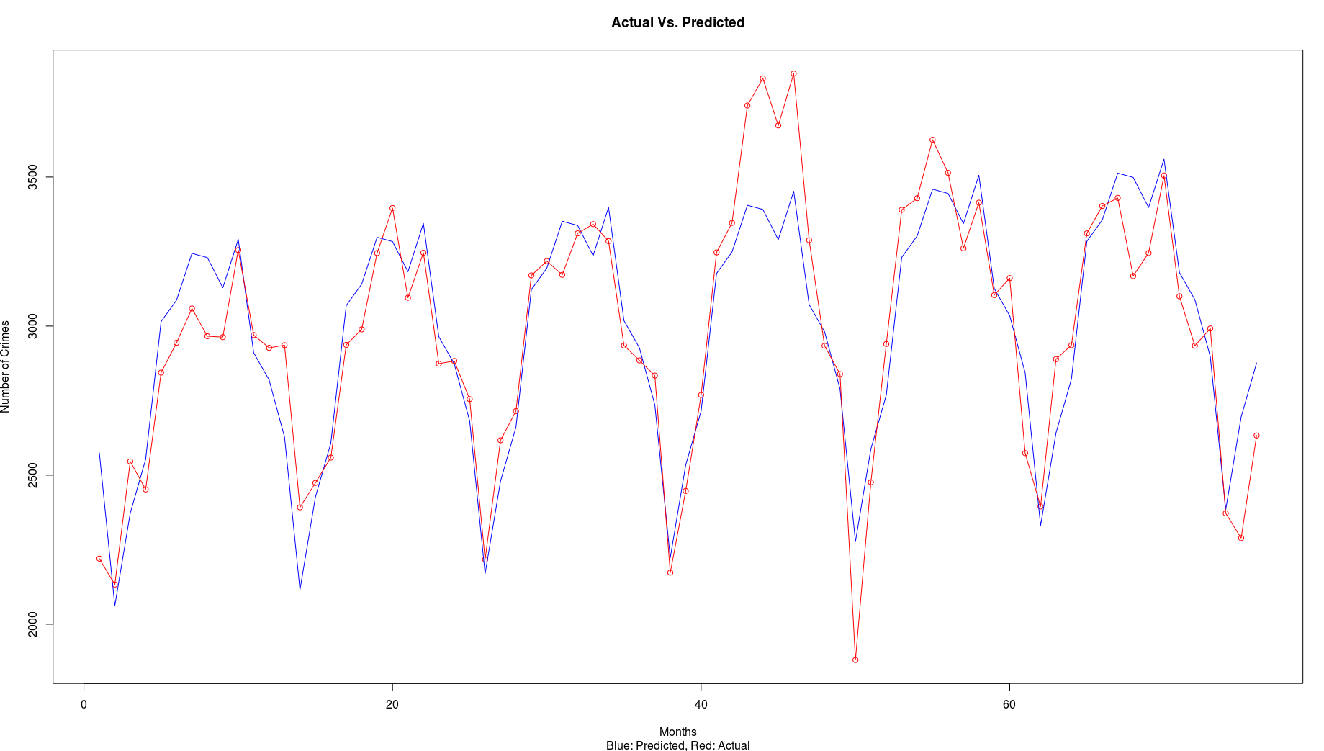
Regression Summary: 司文化
Mean Absolute Percentage Error: 4.7%

Slide 8
PART Two
02
DBSCAN algorithm for Clustering Crime spots

Slide 9
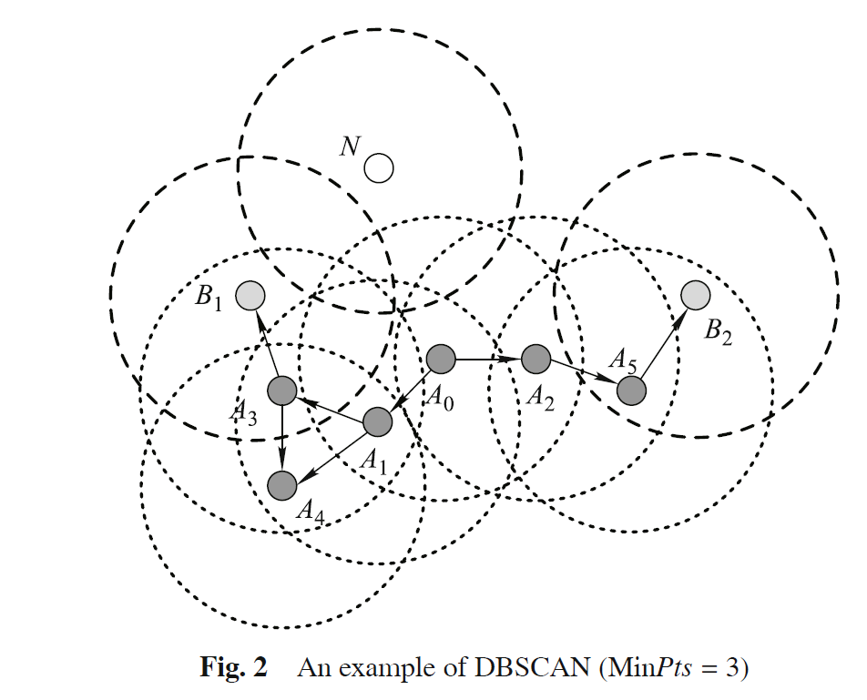
公Why DBSCAN instead of K-Means?
司文化
1
User doesn’t need to specify number of cluster to be generated
2
Cluster doesn’t have to be circle
3
Identify outliers
DBSCAN features:
Core Point/Neighbor Point/Noise Point
Set Radius & minPoints
Reference:https://www.researchgate.net/publication/260523383

Slide 10

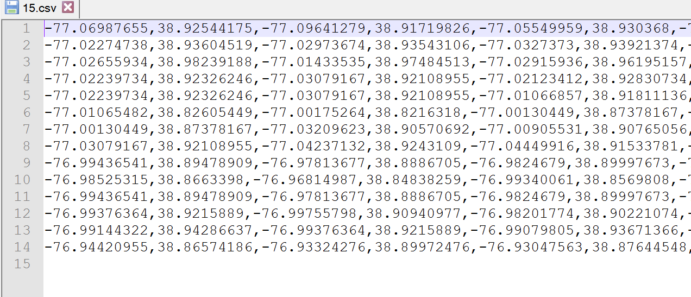
DBSCAN Hadoop Map-Reduce implementation
Data source & Partition
10000 crime incidents in 01/2017-04/2017 (Longitude, Latitude)
14 partitions based on location
Around 1000 points for each partition
Before map…
Put each partition points into one line (X1,Y1,X2,Y2…)
Put all partitions into one text as the input file of map
Upload input file into HDFS

Slide 11
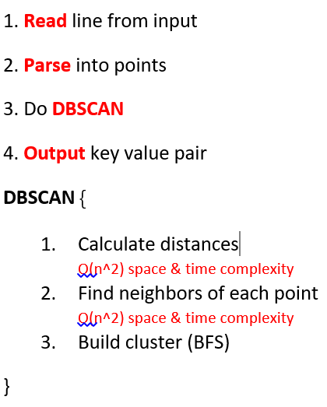
Map Design
司文化
Input key: PatitionIndex, Value: Points in Partition
Output Key: Point Value: ClusterID
DBSCAN Parameters
Distance calculated by longitude and latitude, unit = km
Set radius = 0.5, minPoint = 15 (Both adjustable)
Map Workflow

Slide 12
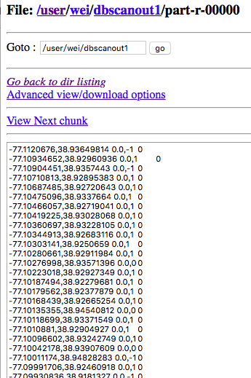
Reduce Design
司文化
Input: Output of Map
Output Key: Point, Value: ID
Reducer reads the result of map output into HDFS
Will enhance reduce function later…
Merge adjacent clusters

Slide 13
PART Three
03
Result visualization & Front End Demo
Notes:
i will visualize and interpret our analysis results. let’s start our journey.
firstly, l will show the scatter plot by using the raw data. there are more than 10 thousand points. those points are all in a mess.this map shows no regularity
When we apply DBSACN algorithm to the data, we set the same radius at 0.5 KM around 0.3 mile. but with different minimum points. the minimum points are 15,25,50,75. in the maps, with the threshold is increasing, an increasing number of points become noise points and have been wiped out.
we finally find 4 crime hotspots. all of them are in the residential areas in middle north of DC.

Slide 14
PART Four
04
Conclusion & System Improvement

Slide 15
公Conclusion & Future work
司文化
Conclusion
System Improvement
Time: Crime occurrences have a repetitive pattern. Crime highest in summer and lowest in winter
Location: Police can take proactive actions such as assigning more force at crime hotspots
Enhance Reduce function to merge two clusters on the border of two partitions
Try taking more components (cyclical) into consideration to improve the time series model
Perform categorical analysis to observe fluctuations in detail

Slide 16
End
Q&A
Thank you

